Slide 1
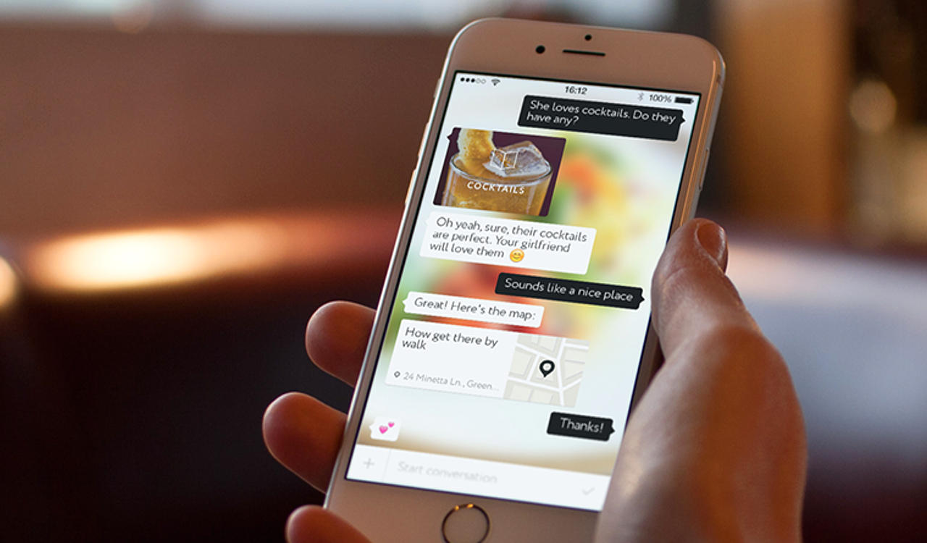

W.O.M. Restaurant Recommendation System

Slide 2





Revengers
Arun Ramakrishnan
Juily Vasandani
Maharshi Dutta
Samir Husain
Yizhu Liao

Slide 3



Agenda
Business Problem
Analytics Problem
Solution
Shiny App Presentation
Long-term scope

Slide 4
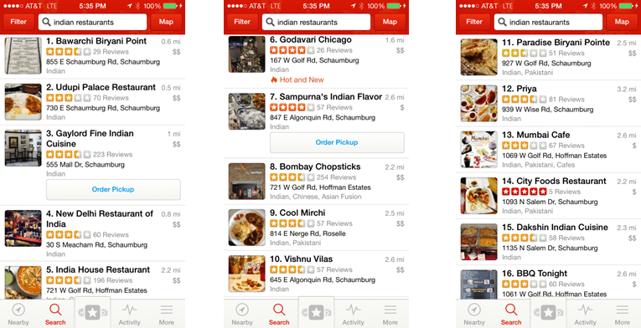
Business Problem
Current Restaurant Recommendation System： Restaurant- Focus
Yizhu
Business Problem
Analytics Problem
Solution
App Presentation
Long-term Scope

Slide 5
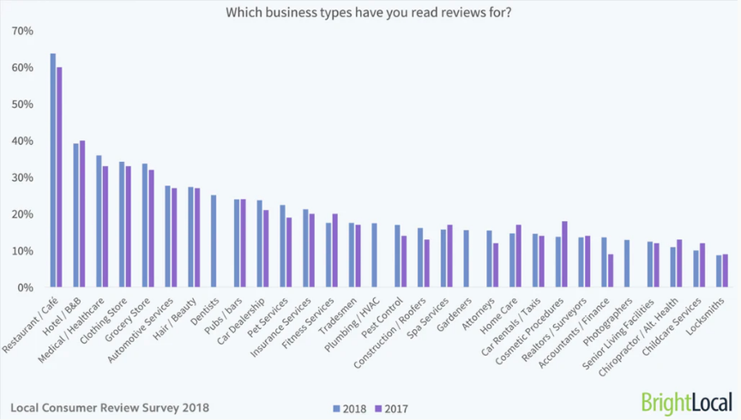
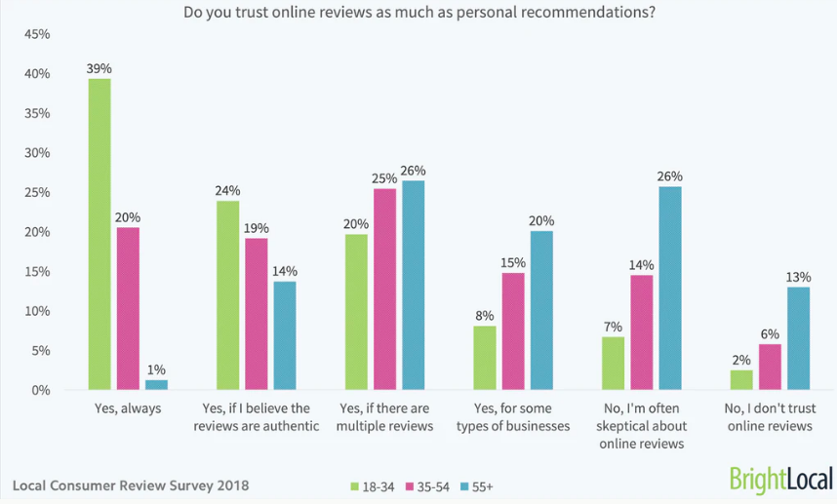
Business Problem
Customers expect more personalized recommendation and trust WOM (Word of Mouth)
BrightLocal
BrightLocal
Yizhu
Business Problem
Analytics Problem
Solution
App Presentation
Long-term Scope

Slide 6
Analytics Problem
Objective
Personalized restaurant recommendation
Increase customer satisfication
Approach
Exploring Yelp Review Data
Solution
Natural language processing (NLP)
Cosine similarity for finding closest review
Identifying similarities of restaurants
Samir
Business Problem
Analytics Problem
Solution
App Presentation
Long-term Scope

Slide 7

SOLUTION

Slide 8
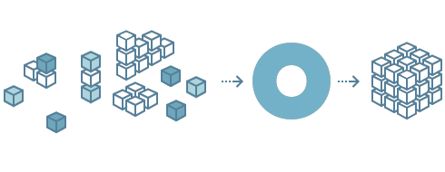
Data
Get review text
Cleanse text and remove punctuations
Tokenize
Remove stop words
Samir
Business Problem
Analytics Problem
Solution
App Presentation
Long-term Scope

Slide 9
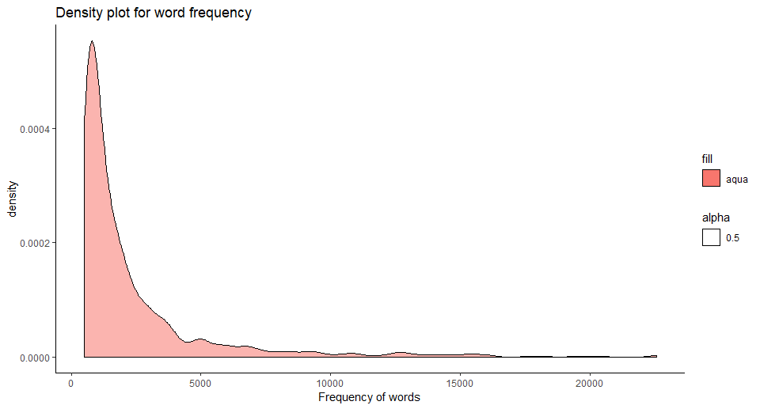
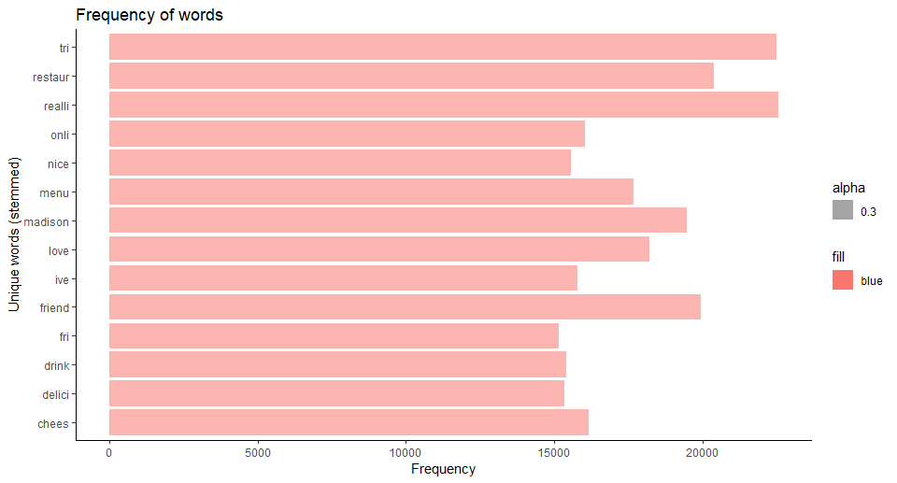
Exploration
Samir
Business Problem
Analytics Problem
Solution
App Presentation
Long-term Scope

Slide 10
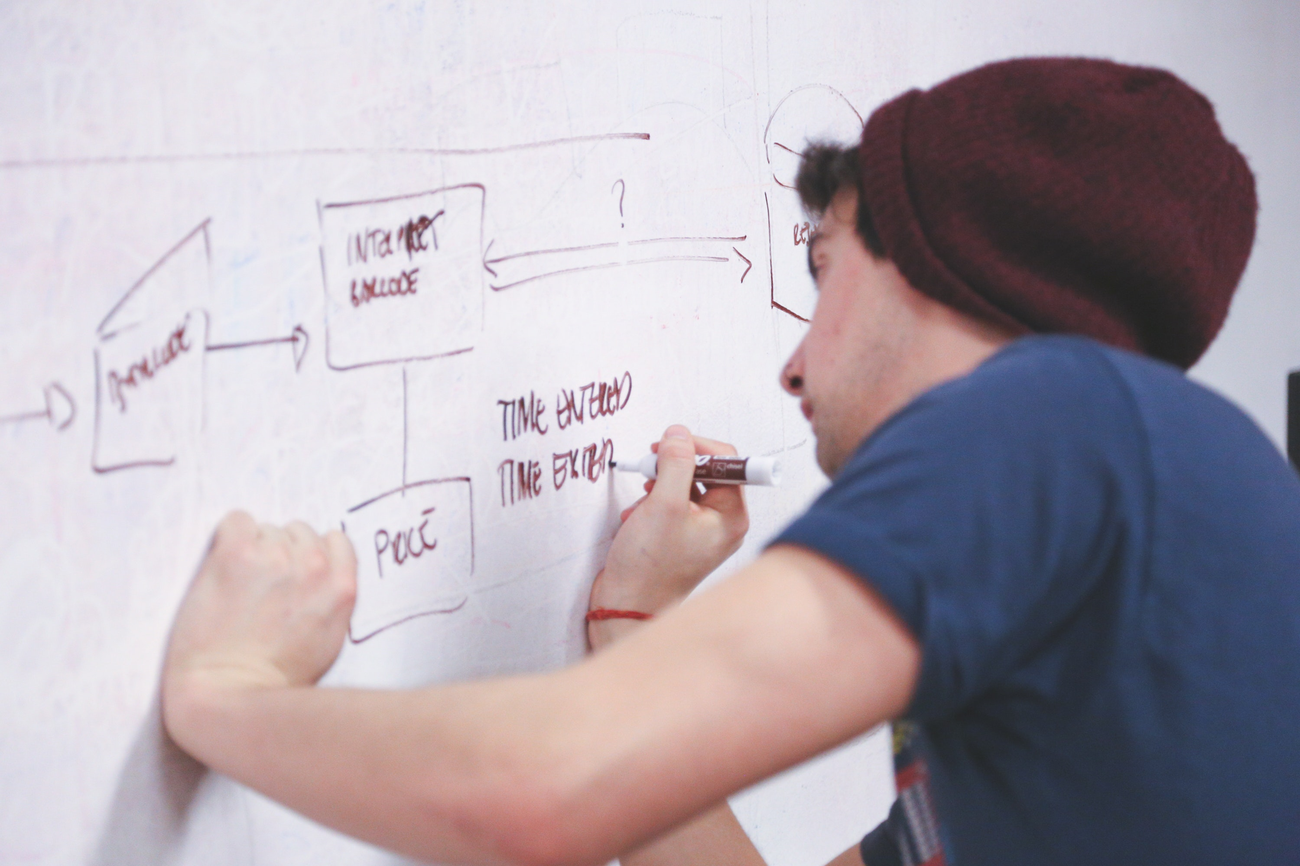
Methodology

Slide 11
Exploration
Samir
Business Problem
Analytics Problem
Solution
App Presentation
Long-term Scope

Slide 12
Document-Term Matrix
Unique Words
Frequency
List of Restaurant
Arun
Business Problem
Analytics Problem
Solution
App Presentation
Long-term Scope

Slide 13
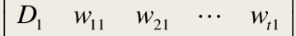
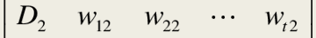
Cosine Similarity
A =
Log (
)
B =
Log (
)
Arun
Business Problem
Analytics Problem
Solution
App Presentation
Long-term Scope

Slide 14
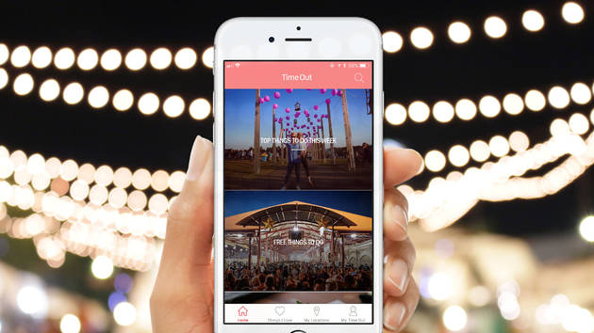
Shiny App Presentation

Slide 15
Functionality
User Profile
Yelp Login
Reviews
Highlight customer history
Recommend
Derived from user’s reviews
Maharshi
Business Problem
Analytics Problem
Solution
App Presentation
Long-term Scope

Slide 16

DESIGN

Slide 17

SHINY APP DEMO
Juily
Business Problem
Analytics Problem
Solution
App Presentation
Long-term Scope

Slide 18
Long term scope
A scalable system applicable to other institutions
Juily
Business Problem
Analytics Problem
Solution
App Presentation
Long-term Scope

Slide 19

Thank you
ramakr17@purdue.edu; husain2@purdue.edu; jvasanda@purdue.edu; liao71@purdue.edu; dutta33@purdue.edu;

Slide 20
References
fahd09. (2019, January 4). Yelp Dataset: SurpriseMe Recommendation System. Retrieved from https://www.kaggle.com/fahd09/yelp-dataset-surpriseme-recommendation-system.
liu1498. (2018, October 12). Movie-Recommender-System-ShinyApp. Retrieved from https://github.com/liu1498/Movie-Recommender-System-ShinyApp.
Natural Language Processing with R. (n.d.). Retrieved from http://rpubs.com/LuizFelipeBrito/NLP_Text_Mining_001.
Yelp, Inc. (2019, February 5). Yelp Dataset. Retrieved from https://www.kaggle.com/yelp-dataset/yelp-dataset.

